Slide 1
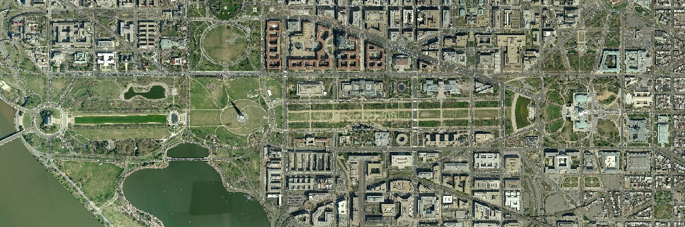
The Bright Future* for
Open Source in Government
(*with some Growing Pains)
OSCON
July 21, 2010
Bryan Sivak
Chief Technology Officer, District of Columbia
@BryanSivak
Bryan.Sivak@dc.gov
http://OCTO.dc.gov

Slide 2




Slide 3








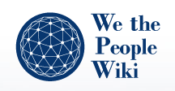






Slide 4
?

Slide 5
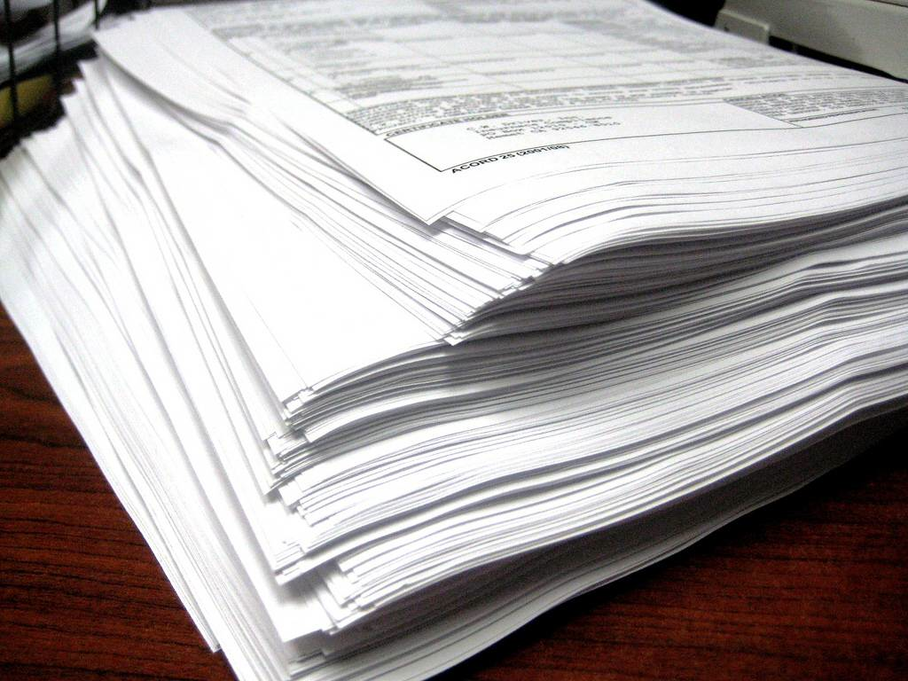
Photo by sonrisa electrica

Slide 6

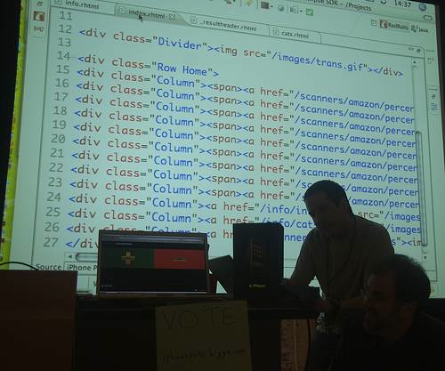

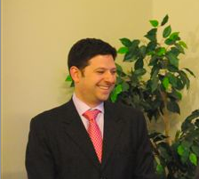
Photo by Steve Rhodes
Notes:
Top down vs bottom up

Slide 7
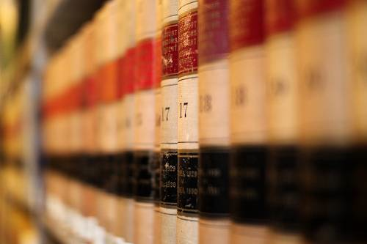
Photo by Mr. T in DC
Notes:
Procurement

Slide 8
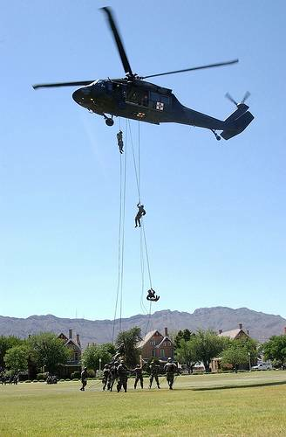
Photo by Steven Baack
Notes:
Support

Slide 9

Photo by AMagill
Notes:
Cost

Slide 10

Notes:
Cost

Slide 11

Notes:
Cost

Slide 12

Notes:
Cost

